Slide 1
A day in the life of covid 19

Slide 2
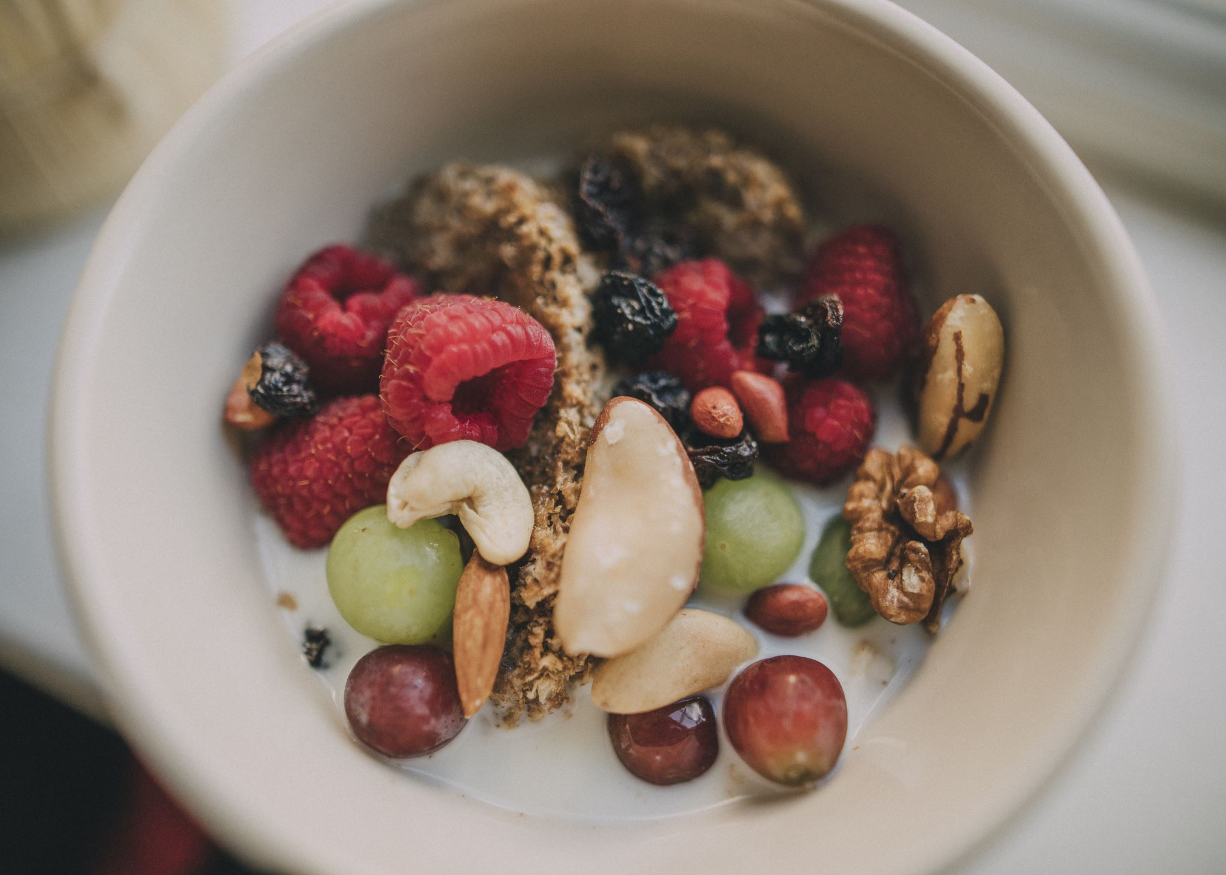
Breakfast
I would get up with my family and have breakfast sometimes I would have pancakes and sometimes I would have cereal .

Slide 3


Get dressed
Depending on the weather I would normally where jeans and a top

Slide 4
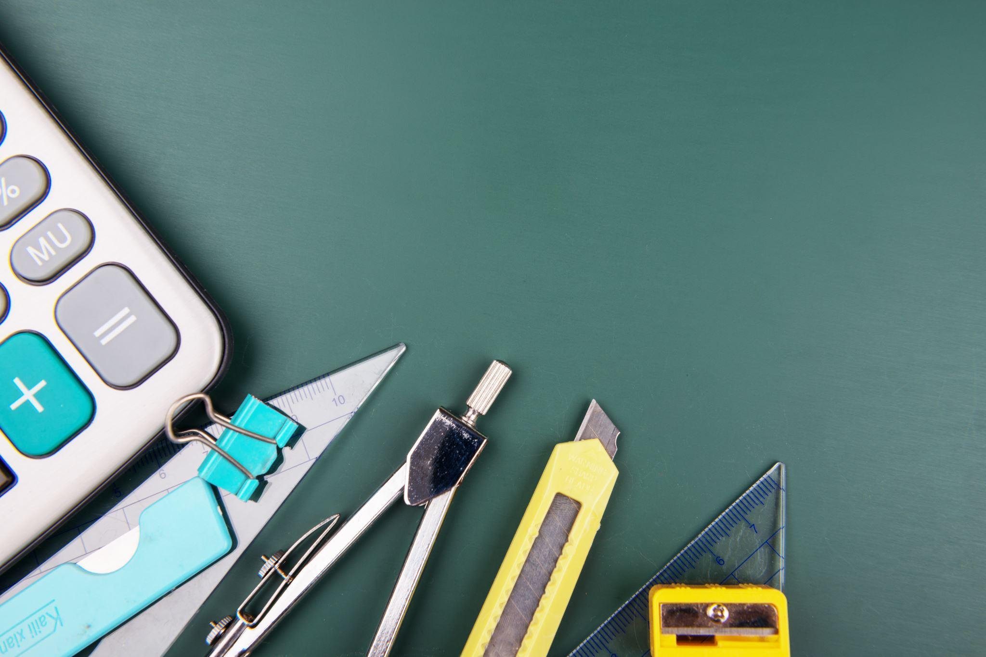
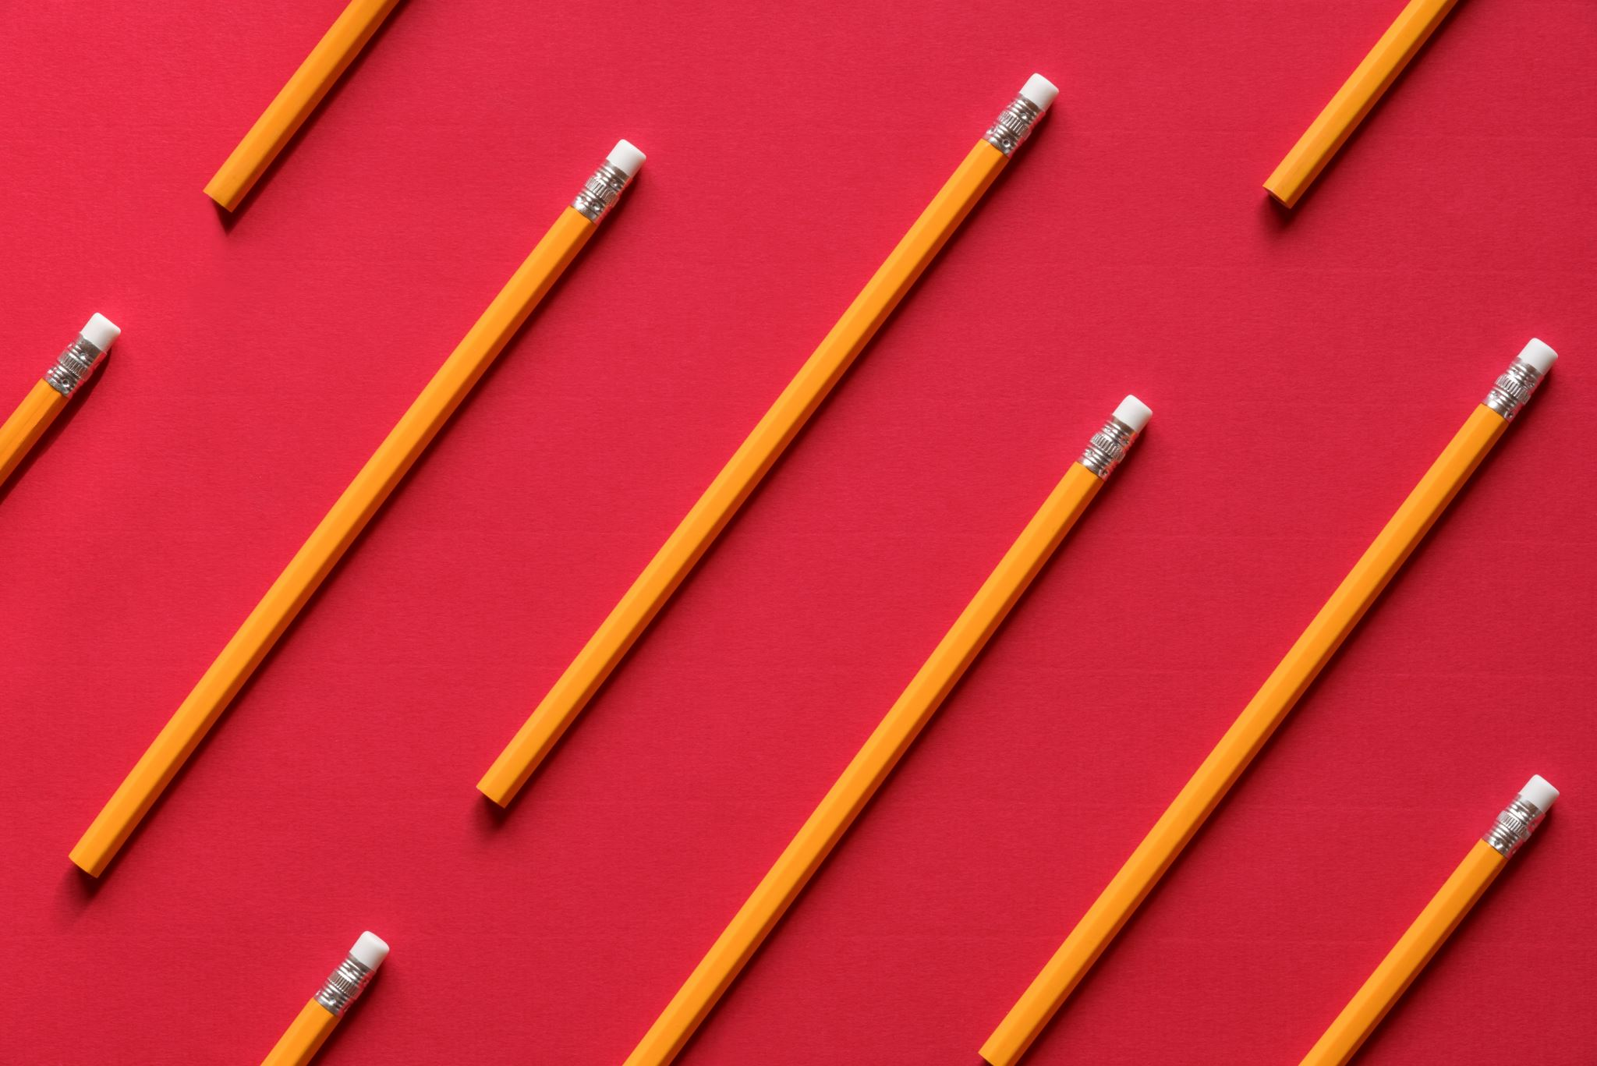
Start work
I would first do my vle then send it to my teacher. After that I would do some workbook .

Slide 5
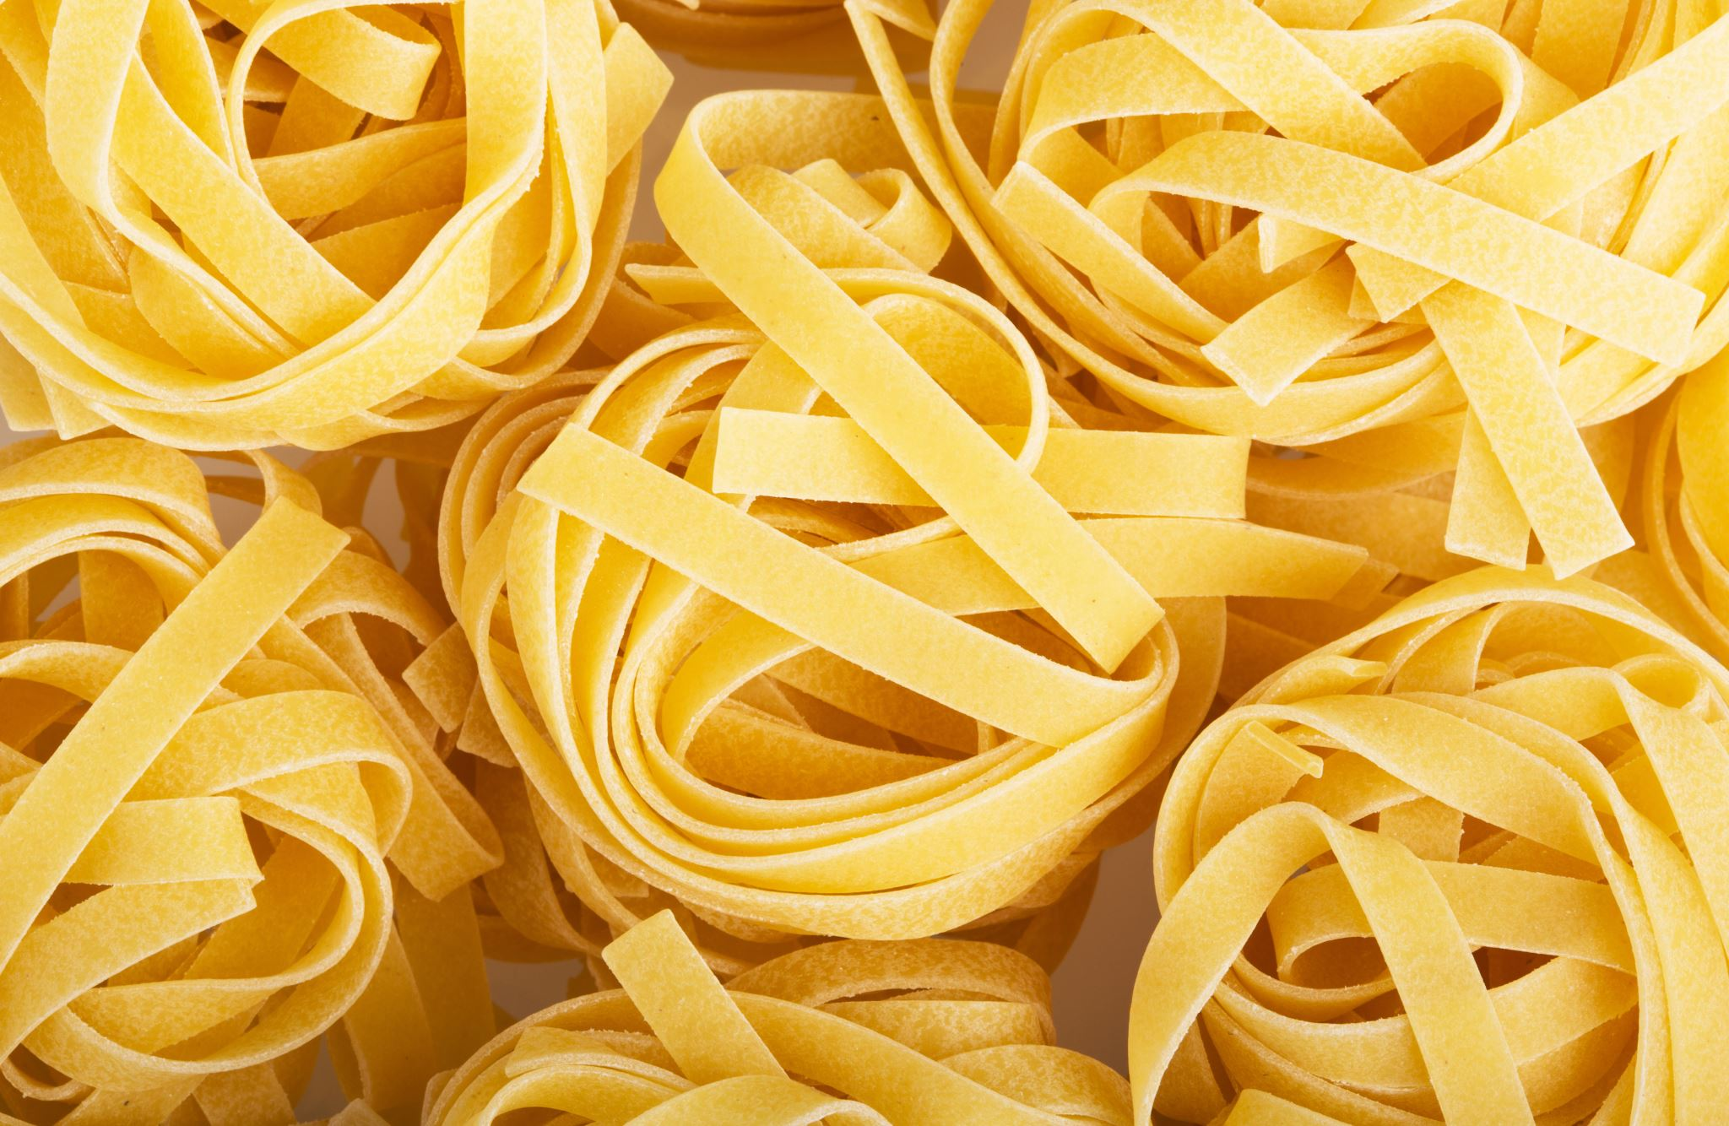
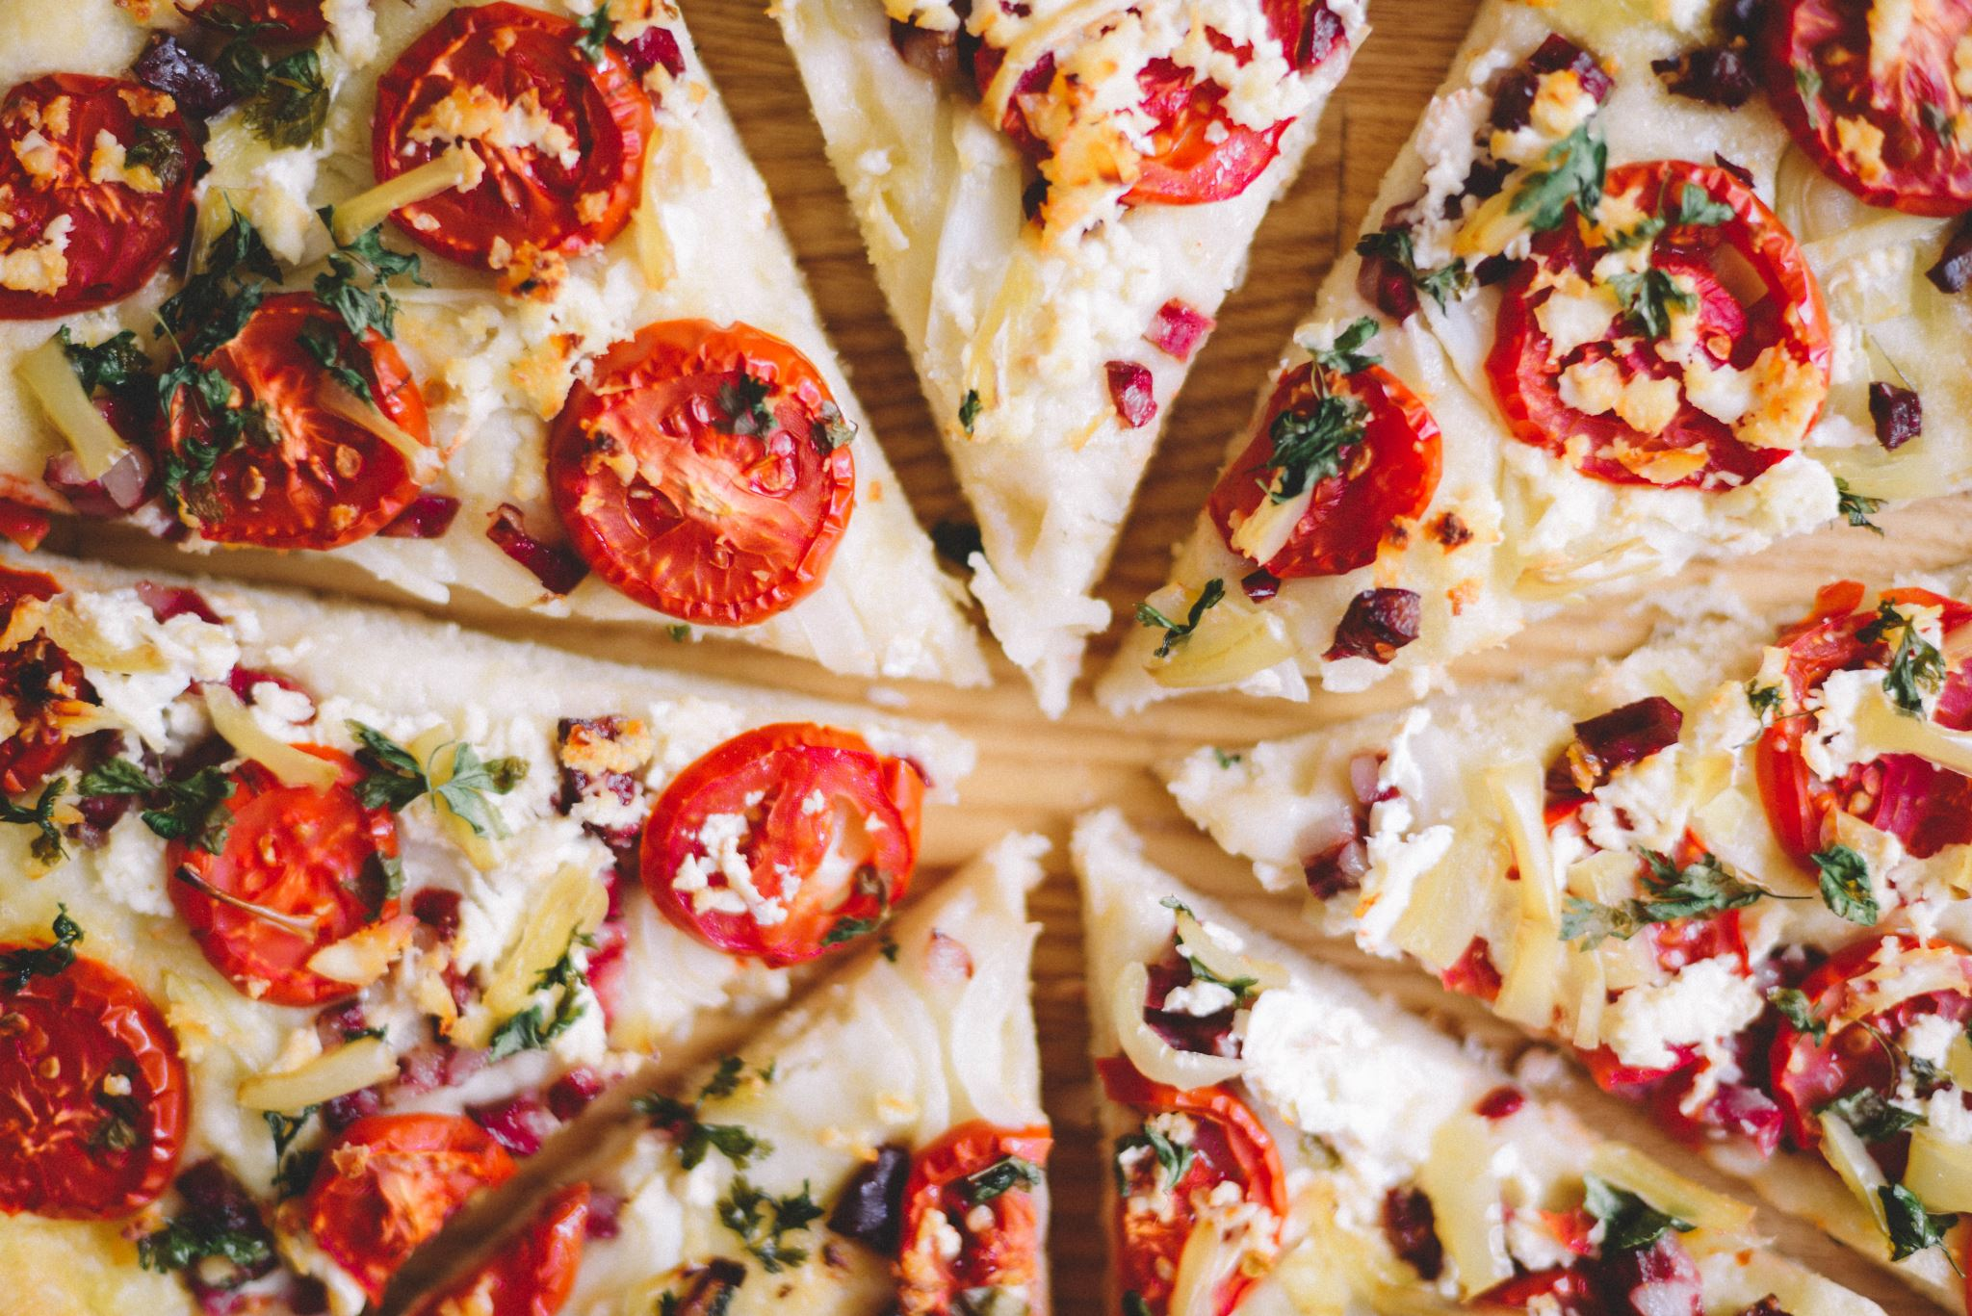


Lunch
food

Slide 6
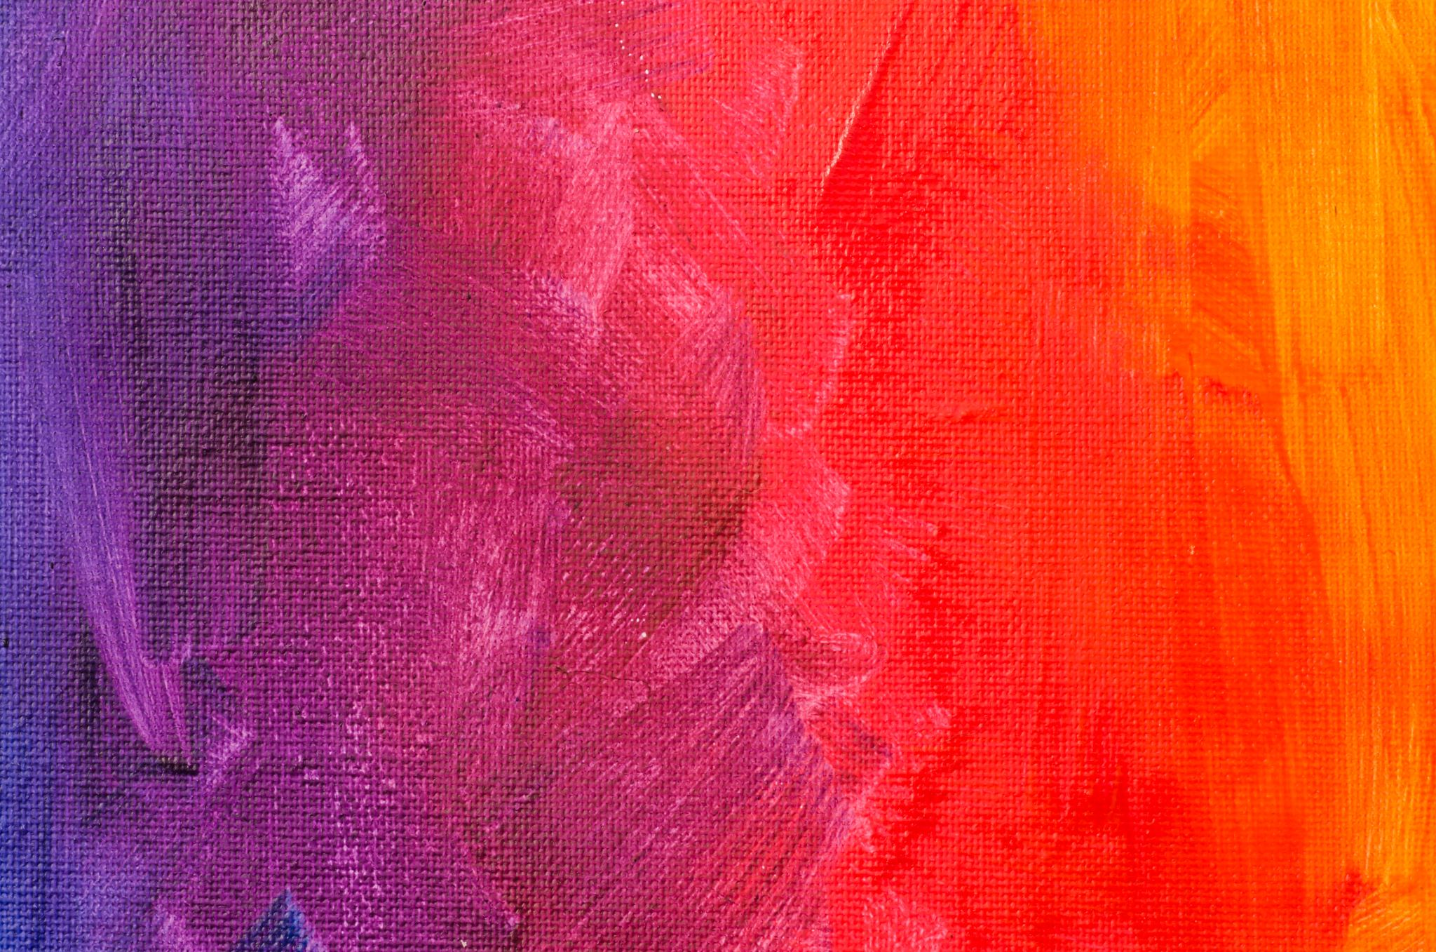

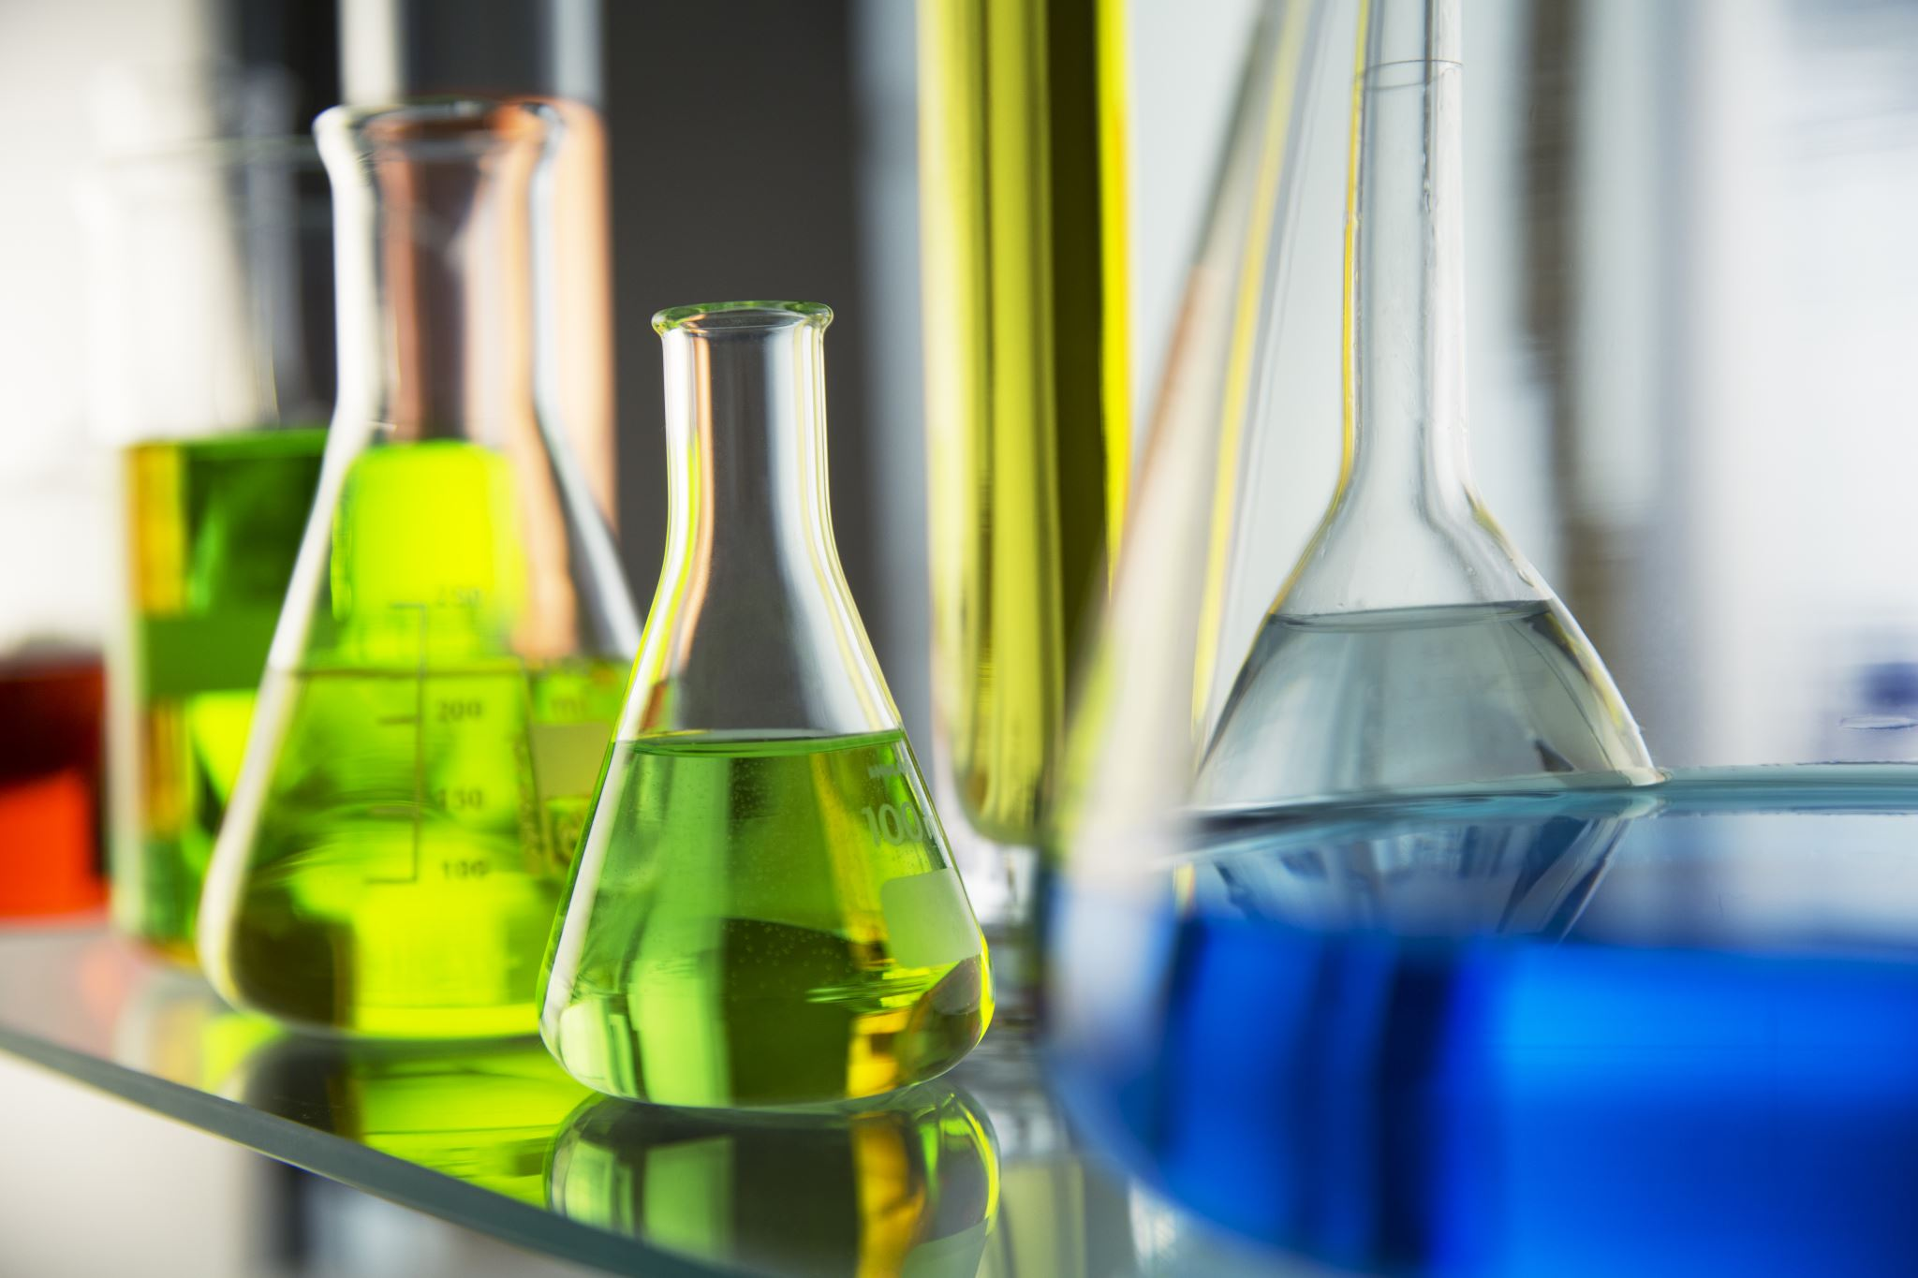

Tech or art
I would either do tech based school work or some nice art sometimes even science experiments

Slide 7
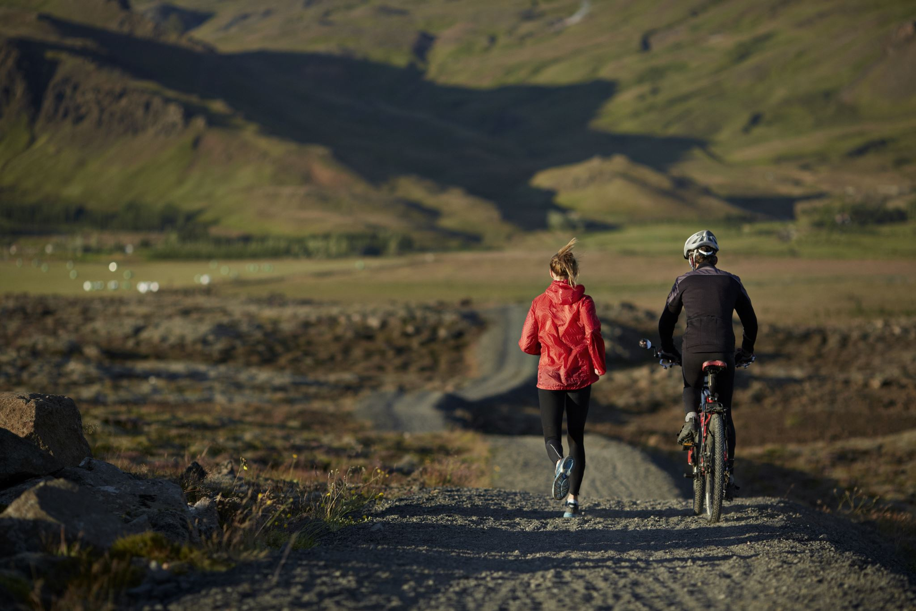
Walk/bike ride
I would go on a bike ride with my mum if willow was asleep . If not then I would walk .

Slide 8
Tea and bath
Lastly, I would have tea and have a bath with myself.

