Slide 1
WHAT I HAVE BEEN DOING

Slide 2
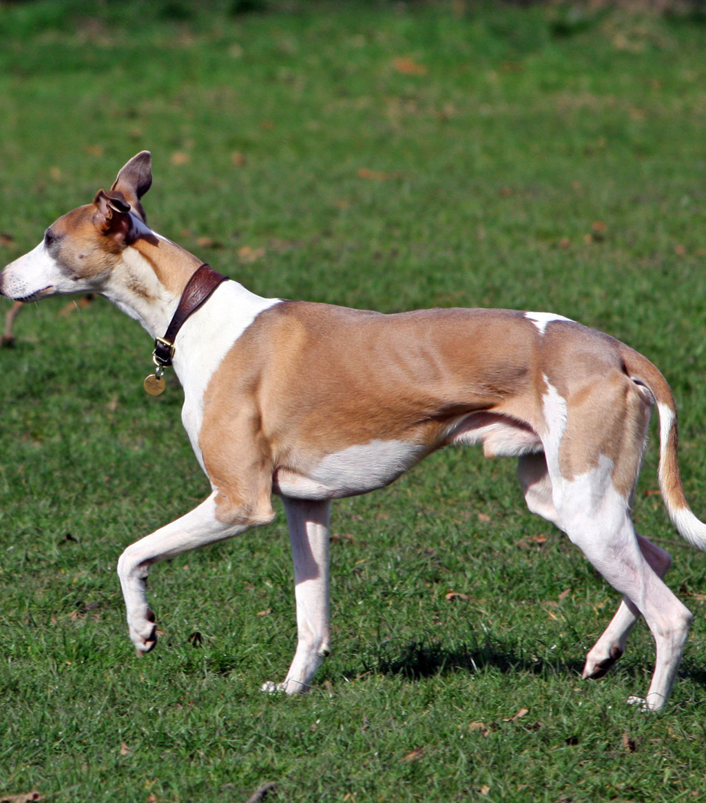
NUMBER 1
Taking my dog out for a walk

Slide 3
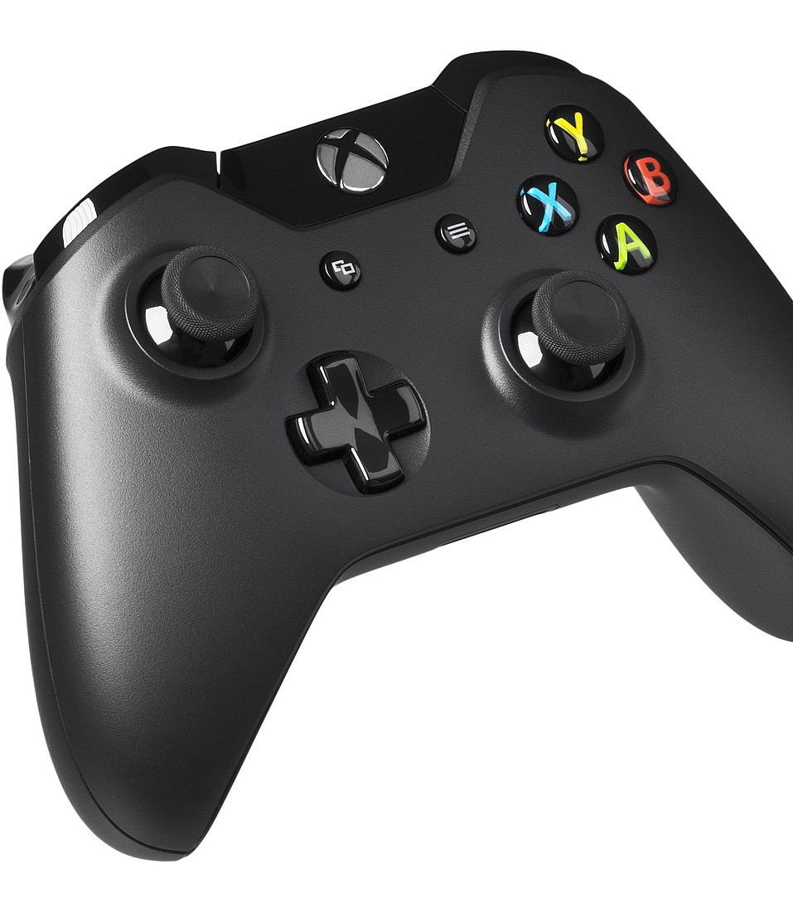
NUMBER 2
Playing on my xbox

Slide 4

NUMBER 3
Facetiming my friends

Slide 5

NUMBER 4
Walking with my friends

Slide 6

NUMBER 5
Doing school work

Slide 7
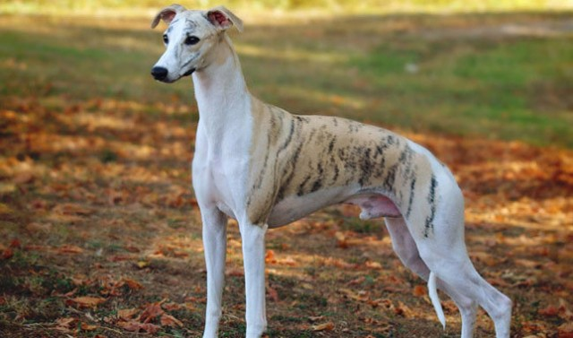
BYE
Hope you liked it

