Slide 1
Drowning in plastic.
Here is a presentation about plastic waste spreading and getting stuck in animals.

Slide 2
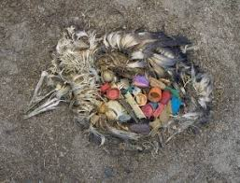
Drowning in plastic
This is what could happens when we do not recycle so we need to act now.
Pufgggs

Slide 3
DON’T THROW PLASTIC ON THE FLOOR.
FIVE TOP TIPS
1) DON’T THROW PLASTIC ON THE FLOOR.
2) USE RE-USEABLE BOTTLES INSSTEAD OF CHUCKING IT AWAY.
3) USE WOODEN TOY’S OTHER THAN PLASTIC ONES.
4) USE PAPER WISELY
5) DONATE DON’T BIN (this works with clothes, shoes and anything you can reuse

Slide 4

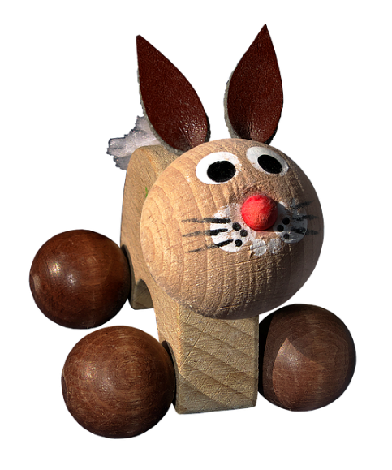
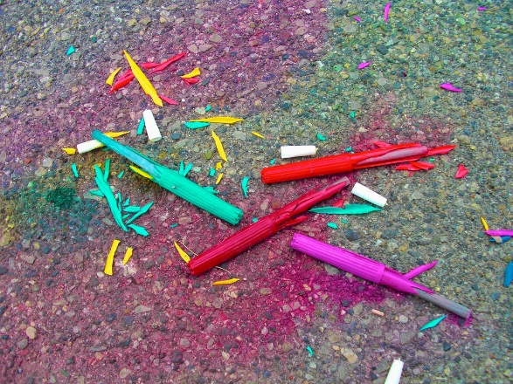
Make reusing plastic fun
IF YOU ARE UNDER THE AGE OF 6 YOU COULD BUY WOODEN TOYS AS THEY DON’T COST MUCH AND ARE FUN TO.
DO YOU HAVE ANY BROKEN STATIONARY (PENS, PENCILS, RULERS ETC) YOU COULD REUSE SOME PARTS TO CREATE SOMETHING ARTSY.
USE A REUSABLE WATER BOTTLE BUT DECORATE IT WITH STICKERS TO MAKE IT FUNKY AND PRETTY.

Slide 5
WHY IS REUSING PLASTIC IMPORTANT
IF WE DON’T ACT NOW IT IS ESTIMATED THAT BY 2050 THERE WILL BE MORE PLASTIC IN THE OCEAN THEN FISH. SAVING THE EARTH IS IMPORTANT AND WE CANT DO IT WITHOUT YOU SO PLEASE HELP NOW AND WE HOPE YOU’VE LEART HOW TO HELP.

